Slide 1




n
Library Management System
Debuggers++
Ali walid 24-101042
Arwa Ayman 24-101186
Farida Osama 24-101513
Abdelrahman Farag 24-101501

Slide 2
Project Overview
This project is a Library Management System built using C++
It allows Customers to view books, search for books , borrow a book or return a book.
Librarians can add/remove customer, and add/remove/search and view books

Slide 3
System Features
User login using username and password
Book search by title, author, or category
Borrow limit max 5 books per customer
Separate views for librarian and customer

Slide 4
Book Class
stores information about a book which includes title, author, category and a borrowed field
Functions : Set and get book details, Mark book as borrowed or returned and Check borrow status

Slide 5
User Class
Library Class
Stores: all books of the library in an array
Functions: Add or remove a book
,Search by title, author, or category and Display borrowed or available books
Stores: id, username and password
Function: Handle login

Slide 6
Customer Class
Librarian Class
(inherits from User)
It can :
Add/remove customers
Add/remove books
Search and view all books
View all borrowed/unborrowed books
View customer data and their borrowed books
(inherits from User)
It can:
Search books (by title, author, category)
View own borrowed books
Borrow a book (max 5 books)
Return a book

Slide 7
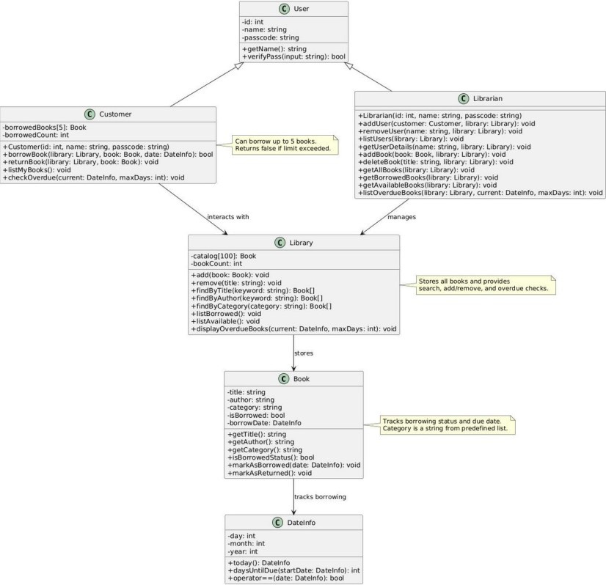
UML

Slide 8
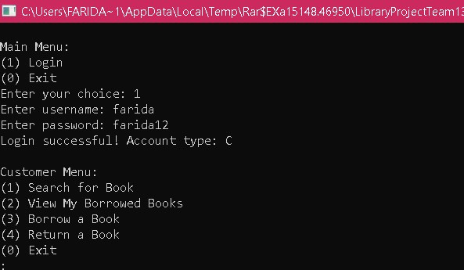
Test case

Slide 9
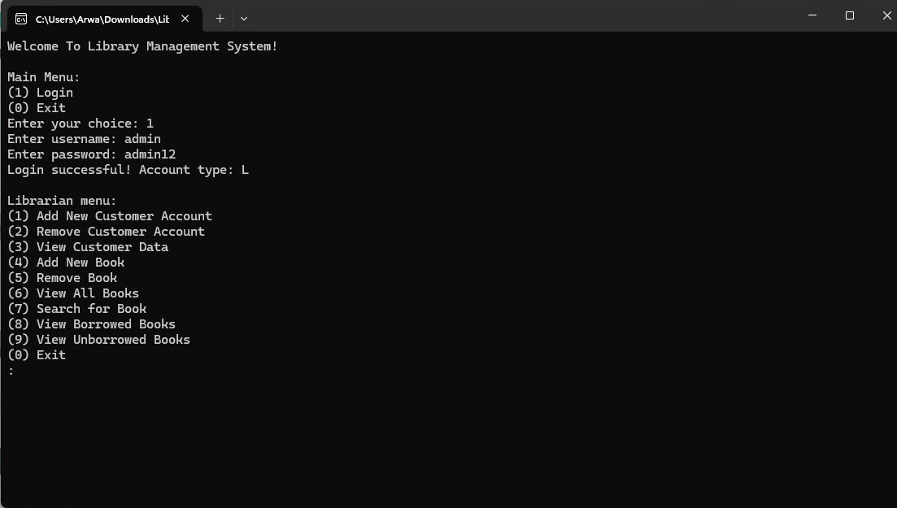

Slide 10
THANK YOU

